Slide 1
Types of Trademarks

Slide 2
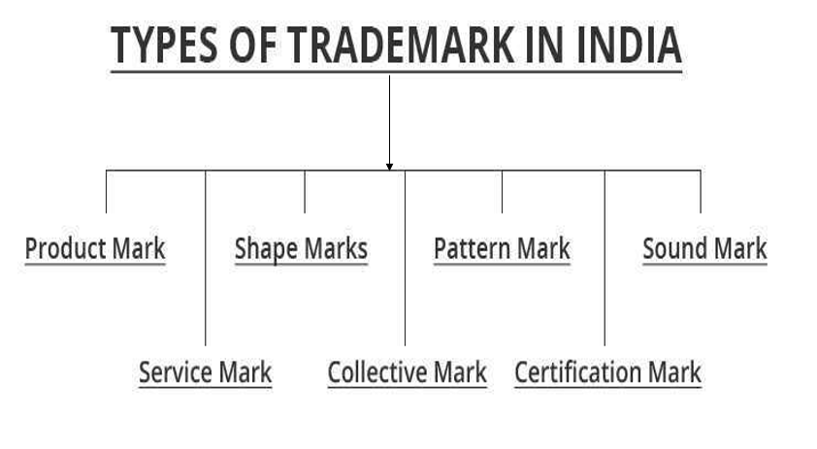

Slide 3
IP protects:
A) Physical assets
B) Ideas and creations
C) Only software
D) Only brands

Slide 4
IP protects:
A) Physical assets
B) Ideas and creations ✅
C) Only software
D) Only brands

Slide 5
Main purpose of IP:
A) Tax collection
B) Encourage innovation
C) Reduce competition
D) Public awareness

Slide 6
Main purpose of IP:
A) Tax collection
B) Encourage innovation ✅
C) Reduce competition
D) Public awareness

Slide 7
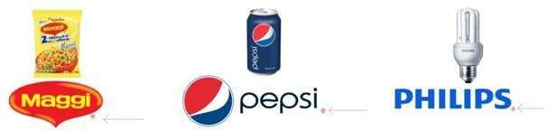
Product Mark
Similar to trademark
Identify the products or goods instead of services
Product is the unique selling feature of the company
Initially, TM, which states that the mark is not yet registered.
Once they are registered, they have to use ®.
Examples: Pepsi®, Maggi®, PHILIPS® etc.
Notes:
Intellectual Property (IP) = Legal protection for creations of the mind Why IP exists
Encourages innovation
Prevents copying
Enables monetization
Protects business identity
Trademarks → Brand identity
Patents → Inventions
Copyright → Creative works
Designs / GI → Specialized protection
Core Definition
Trademark = distinctive sign identifying source of goods/services
Types of Trademarks (DO NOT RUSH THIS — HIGH MCQ AREA)
1. Product Mark
Identifies goods (not services)
Example: Pepsi®, Nike logo
TM → unregistered
® → registered
👉 Stress point: Students confuse TM vs ® — don’t let that slide.

Slide 8
Examples of Product Marks:
Apple's Logo
Nike's Swoosh
Coca-Cola
Notes:
Apple's Logo: The iconic bitten apple logo is a product mark associated with Apple devices like iPhones, iPads, and MacBooks.
Nike's Swoosh: The swoosh logo is a product mark that identifies Nike's athletic footwear and apparel.
Coca-Cola: The distinctive script logo and name represent the Coca-Cola brand and its beverages.

Slide 9
Service Mark
Identify and distinguish the services rather than the products
Symbol is SM and not TM.
Features of a Service Mark
Service Identification
Source Indicator
Non-Tangible Association
Notes:
Service Identification: It is used to identify and promote services rather than goods.
Source Indicator: It signifies the origin of the service, helping consumers associate it with a particular business.
Non-Tangible Association: Unlike product marks, service marks are linked to non-physical offerings like hospitality, education, or financial services.

Slide 10
Examples of Service Marks:
FedEx:
McDonald's Golden Arches
Netflix
American Airlines Logo
Notes:
FedEx: The name and logo represent shipping and delivery services.
McDonald's Golden Arches: Associated with the restaurant and food service industry.
Netflix: The name and logo are service marks for online streaming services.
American Airlines Logo: Identifies airline transportation services.

Slide 11
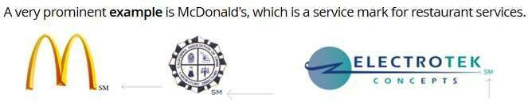

Slide 12
Collective Mark
A collective mark is owned by a collective
Identify their goods and services
Distinguish their goods and services from those of non-members
Indicate membership in the group.

Slide 13

Examples
Notes:
Examples are like "CA" device is used by the members who fall under Institute of Chartered Accountants; another example is "CPA" which denotes members of the Society of Certified Public Accountants.

Slide 14
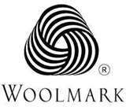

Certification marks
Define "standard" of goods and services.
Examples of common certification marks include:
UL (Underwriters Laboratories
Fair Trade
Energy Star .
Organic Certification
Notes:
Woolmark, which is certified for the fabrics on clothing, Agmark, and ISI.
UL (Underwriters Laboratories): Indicates safety and quality standards for electrical devices.
Fair Trade: Ensures products meet ethical and sustainable production practices.
Energy Star: Certifies energy-efficient appliances.
Organic Certification: Verifies organic farming and production practices.

Slide 15
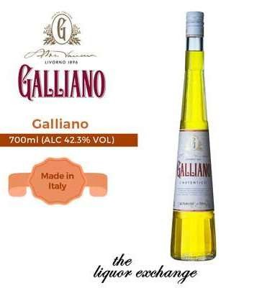
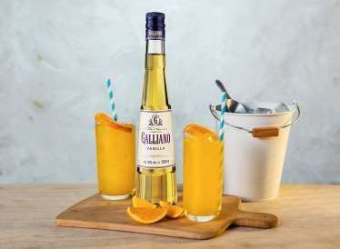
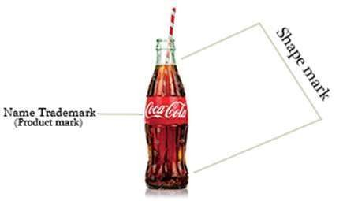
Shape Marks
Type of trademark that protects the three-dimensional shape
Configuration of a product or its packaging
Granted when the shape of the product itself is distinctive and capable of functioning as a source identifier for consumers
Non-traditional trademarks because they go beyond the standard text or logo-based trademarks.
Notes:
Shape marks are a specific type of trademark that protects the three-dimensional shape or configuration of a product or its packaging. These marks are granted when the shape of the product itself is distinctive and capable of functioning as a source identifier for consumers. Shape marks are considered non-traditional trademarks because they go beyond the standard text or logo-based trademarks.

Slide 16
Pattern Mark
Trademark that protect a specific pattern or design
Pattern or design used consistently to identify the source of goods or services
Examples of Pattern Marks
Gucci GG Pattern
Louis Vuitton's Monogram Pattern

Slide 17
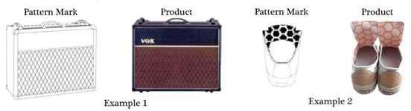

Slide 18
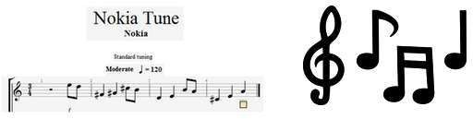
Sound Mark
Trademark that protect a specific sound or combination of sounds
Sounds used to identify and distinguish the goods or services of a particular brand
Segistered when the sound is distinctive enough to be recognized by consumers

Slide 19
Loss of Rights
Improper use / licensing (Allowing others to use your trademark without quality control)
Genericide (becomes so commonly used that it loses its distinctiveness )
Non-use (Failure to use the trademark in commerce)
Failure to police (Not taking action against infringement)
Failure to renew (Not renewing the trademark registration after its validity period.) 10 years

Slide 20
Benefits of Registration
Legal ownership proof
Exclusive rights
Can license/sell
Builds goodwill

Slide 21
Symbol used after registration:
A) TM
B) SM
C) ®
D) ©

Slide 22
Symbol used after registration:
A) TM
B) SM
C) ® ✅
D) ©

Slide 23
Which is NOT a trademark type?
A) Sound mark
B) Pattern mark
C) Algorithm mark
D) Shape mark

Slide 24
Which is NOT a trademark type?
A) Sound mark
B) Pattern mark
C) Algorithm mark ✅
D) Shape mark

Slide 25
Trademark loss can occur due to:
A) Regular use
B) Enforcement
C) Non-use ✅
D) Registration

Slide 26
Trademark loss can occur due to:
A) Regular use
B) Enforcement
C) Non-use
D) Registration

